Slide 1
CTUIR Family Violence Services Program
Elder Abuse Awareness Training
March 29, 2012
Wildhorse Resort & Casino
Notes:
Please acknowledge training materials origins: Office on Violence Against Women, U.S. Department of Justice in partnership with the National Clearinghouse on Abuse Later in Life, Federal Law Enforcement Training Center, National Sheriffs'’ Association.

Slide 2
Introductions
Dave Williams, CTUIR Tribal Police
Dave Brehaut, APS
Donyale Ezell, CTUIR Family Violence Services Program.
1.2
1.2

Slide 3
Key Training Points
Focus on victim safety
Be aware of and avoid assumptions
Recognize abuser tactics
Work collaboratively
1.3

Slide 4
What is Elder Abuse?
When an older adult experiences:
Physical, sexual, or emotional abuse
Neglect
Financial exploitation
(Any of the above may co-occur with each other)
1.4
Notes:
1.4
What is Elder Abuse?
When an older adult experiences:
Physical abuse, sexual or emotional abuse
Neglect
Financial exploitation
***Instructors’ Note: Several additional comments could be made when defining what elder abuse is.
Generally, multiple types of abuse occur simultaneously. As a result, if you suspect one form of abuse, investigate for other forms.
Emotional abuse is often present in cases of elder abuse and will be briefly discussed.
If abandonment or abduction are included in your state statutes, note that these types of abuse will be addressed when statutes are described.
All these types of elder abuse involve a perpetrator. In many states, statutes include self-neglect as a form of elder abuse. Self-neglect will be covered briefly in the module on neglect.

Slide 5
Who are Victims of Elder Abuse?
Age: over 60 CTUIR; 65 + State of Oregon
Gender: Majority of victims are female; but also older males
All racial, ethnic, socio-economic, and religious backgrounds
.5
Notes:
1.5
Who are the Victims?
For the purposes of this training, older persons or potential victims include:
Persons age 60 – 65 and up, depending on state statutes. For the CTUIR elder is defined as 60 and over, and for the state is 65 and over.
***Instructors’ Note: Use the correct age for your state.
Primarily older females but also older males.
***Instructors’ Note: Add state or local APS and/or law enforcement reporting statistics.
All racial, ethnic, socio-economic, and religious backgrounds.
***Instructors’ Note: Add state or local information and statistics regarding racial, ethnic, religious and socio-economic demographics of the local community.
Does not include persons 18 – 59 who are considered vulnerable or at-risk adults.
All states have an elder abuse or adult protective services system where social service professionals respond to cases of adult abuse, neglect, and exploitation. In many states, to be eligible for APS services a person must meet the definition of a vulnerable or at-risk adult. Generally the criteria describe a person who is not able to protect him/herself or report the abuse. In many states, this is not an age-based definition, so adults (persons age 18 and older) who meet the criteria can receive APS services. In states that do not have an age-based definition, some elder abuse victims are eligible for APS services but not all, since many older adults are not vulnerable/at-risk adults.

Slide 6
Who Commits Elder Abuse?
Intimate partners
Adult children and other family members
Caregivers
Others in positions of authority
Persons with a special relationship with the victim. (CTUIR Criminal Code)
This definition excludes victimization by strangers.
.6
Notes:
1.6
Who Commits Elder Abuse?
Intimate partner (long-term, new relationships, late onset)
Occurs in heterosexual and gay and lesbian relationships
Includes dating relationships
***Instructors’ Note: It can be helpful to give examples of these relationships based on the practical experience of the instructor. For example, a long-term relationship is a relationship in which the abuse has been occurring for many years. A new relationship often involves two persons who have been divorced or widowed later in life and are now dating or recently married. Late onset abuse generally describes situations where a long term relationship has not been abusive in the earlier years but now becomes abusive in later life. Medical conditions in which aggressive or violent behaviors are a manifestation of the disease process or body’s reaction to a combination of medications may explain the change in behavior. Keep in mind that in some relationships power and control dynamics have occurred throughout but physical abuse or an escalation of emotional abuse may begin later in life. In these cases, focus on victim safety and abuser accountability.
Adult children and other family members
Caregivers
Others in positions of authority (For example, an administrator of a trust, a representative payee, a guardian, a person with a power of attorney, a translator, etc.)
This definition excludes victimization of older individuals by strangers.

Slide 7
Where Does Elder Abuse Occur?
Private residences
Public settings
Facility settings
.7
Notes:
1.7
Where Does Elder Abuse Occur?
Private residences within community
Public settings
Facility settings
***Instructors’ Note: Let participants know that only 4.5% of older people live in facilities. Therefore most elder abuse victims do not reside in facilities but rather are abused in their private dwellings or public settings.

Slide 8
How Are Older People Harmed?
Accidents
Well-intended caregivers
By persons with physical/mental health conditions who can’t control aggressive behavior
Elder abuse (intent)
.8
Notes:
1.8
WHY DOES ELDER ABUSE OCCUR AND PERSIST?
Trainers: advocate, APS
Slides: 1.14 – 1.20
Method: lecture, video (Pat: 6:25 mins), group discussion
Time allowed: 20 minutes
How are Older People Harmed?
Older adults can be harmed in many ways. Some incidents are not crimes, such as accidents. Other incidents such as well-intended caregivers and persons who cannot control their behavior may require the involvement of social services and health care providers. Abuse, neglect and exploitation are often crimes and require a law enforcement response.
Accidents
Officers are encouraged to investigate if an incident is truly an accident or an excuse used by an abuser to avoid accountability.
Caregivers who are well-intended but unable or untrained to provide proper care
In many cases, individuals are doing their best to provide care but do not know how or physically cannot. For example, an adult child who has a developmental disability and is living with his parents may not be able to provide care for them as they get older, or a 90 pound woman may not be able to properly turn her 250 pound husband who is unable to get out of bed. In these cases, the caregiver may not have the intent to harm the older individual and adult protective services (APS) intervention may be what is needed.
Some abusers may try to excuse the harm caused to the older individual by saying that they do not have the proper skills or training to provide care. The abusers may be attempting to not be held accountable for their abusive behavior or to thwart a possible investigation. In some cases, their real motivation is financial exploitation and they are capable of providing quality care but choose not to.
In all cases, law enforcement should be careful not to jump to conclusions about whether or not the caregiver is well-intended. They should focus on the elements of the crime, gather evidence of the older adult's financial situation, involve APS when appropriate, and consult with prosecutors as necessary.
Contact with persons with a physical or mental health condition who cannot control their behavior
Some abusers have physical or mental health conditions that are organic (such as Alzheimer’s disease, other dementias, or a mental illness) that may result in challenging and aggressive behavior that cannot be controlled. In these cases, which are the exception and not the norm, offenders are unable to control their behavior due to an illness or the effects of new or a combination of medications. Health care professionals should do a complete evaluation to determine what medical remedies may be helpful.
Keep in mind that abusers often use a variety of justifications and excuses for their behavior. A disease or medical condition may be a convenient excuse for abusers so officers should verify if the medical condition exists, if abusive behavior is a possible outcome, and if the aggressive conduct is new or has been occurring for any length of time.

Slide 9
Why Does Elder Abuse Occur & Persist?
Greed
Power and control
.9
Notes:
1.9
Abuse, Neglect and Exploitation: Often elder abuse can be explained by:
Greed in cases of financial exploitation
Some financial exploiters are simply greedy. Their goal is to take whatever they want and steal from the older person. Their victims may be able to come and go as they please and may not be living in classic power and control dynamics but the older individual often experiences a combination of forms of abuse including financial, physical, neglect, and emotional abuse.
Power and Control
Most elder abuse offenders are able to control their behavior and choose to harm or steal from an older individual. Some offenders want to gain and maintain power and control in the relationship, and they set the rules by which the victim must adhere. These relationships may include spouse/partner or caregiver. Some adult children will treat one or both of their parents like servants. These adult children will expect their parents to give money to and serve them. Offenders use actual and assumed power to gain and maintain this control.

Slide 10
Caregiver Stress
Providing care can be stressful
Sometimes the stress is overwhelming and can lead to problems
Caregivers often experience overeating, lack of sleep, depression, etc.
.10
Notes:
1.10
Caregiver stress describes emotions and feelings that some caregivers experience while assisting a person with medical needs or disabilities. Some caregivers feel overwhelming stress, isolation, and possible resentment. In some cases, caregivers will experience substance abuse, self-medication, or health problems as a result of the stress.
Providing care can be stressful.
Sometimes the stress is overwhelming and can lead to problems.
Caregivers often experience overeating, lack of sleep, depression, etc.

Slide 11
Reframing Abuse and Caregiver Stress
Not a cause of abuse
Early research was based on abuser’s self-reports
Abusers used caregiver stress as an excuse to justify their behavior – so they will not be held accountable and to create sympathy for themselves
.11
Notes:
1.11
Reframing Abuse and Caregiver Stress
Early elder abuse research concluded that caregiver stress was a primary cause of elder abuse. This theory suggested that an overwhelmed, stressed caregiver who is providing assistance to a frail, older person may at times unintentionally “snap” and become neglectful or emotionally or physically abusive.
Some initial studies of elder abuse were based on interviews with the abusers who described being overwhelmed and stressed – which caused them to abuse the older individual. Unfortunately, researchers did not take into account that abusers lie, manipulate, justify their behavior, and blame victims, so their explanation of caregiver stress was promoted as a primary cause of elder abuse in early literature and work in the field.
Early research was based on abusers’ self-reports.
Abusers may use the notion of caregiver stress as an excuse to justify their behavior – to create sympathy for themselves so they will not be held accountable.

Slide 12
Reframing Abuse and Caregiver Stress
Everyone experiences stress – most do not abuse, neglect or exploit a parent or partner
The target is the adult – not anyone else
Generally pattern – not an isolated incident
We would not tolerate similar circumstances with children or pets
.12
Notes:
1.12
Current research does not support caregiver stress as a primary cause of elder abuse. While caregiving can be stressful, most caregivers provide loving, gentle care.
There are a number of problems with believing that caregiver stress causes elder abuse.
Everyone experiences stress – most do not abuse, neglect, or exploit a parent or partner. Each of us has times of extreme stress in our personal and professional lives. Most of us do not feel entitled to physically abuse or sexually assault a parent or partner. Most people meet their caregiving responsibilities even if they have had a bad day.
The target is the older adult – not anyone else. In most cases, the perpetrator does not abuse persons with more power (such as a boss or law enforcement officer) or peers (other friends and family). Rather, the target of the harm is the older person.
Generally, abusive behavior is a pattern – not an isolated incident. Caregiver stress as a cause of abuse suggests that the harm is episodic, meaning it occurs infrequently and only when the caregiver is experiencing high levels of stress. Generally the reality is that elder abuse is a pattern of coercive tactics used in combination so the abuser can get his or her way or financially exploit the older individual.
We would not tolerate similar circumstances with children or pets/animals. Too often professionals have walked away from severe physical or sexual abuse or neglect because they have believed the caregiver’s explanation of significant stress and left the older individual in harm’s way.

Slide 13
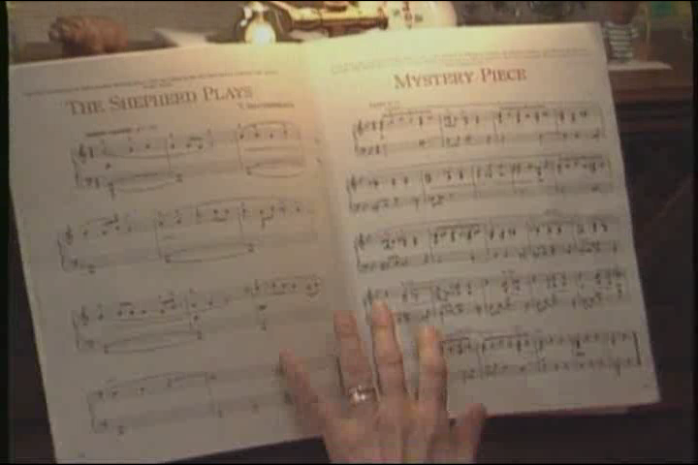
Terra Nova Films:
The Breaking Point (Nancy)
2.13
Notes:
1.13
Transition: “To illustrate how abusers talk about the stress of caregiving, let’s watch another video clip. This older woman will talk about harming her mother. This video clip was created by Terra Nova Films about a woman who wanted to help other stressed caregivers recognize that help is available. The tape has been edited.”
***Instructors’ Note: The key training point is that caregiving can be highly stressful, but stress is not a cause of or excuse for abusive behavior. The role of law enforcement is to determine if a crime has been committed and respond accordingly. Abusers will often use language about stress to shift responsibility for their behavior away from them.
Social services may also be involved with the family by offering support and services. Reducing stress may mean a calmer caregiver but the victim may be no safer, therefore, holding the abuser accountable is often crucial in these cases.
SHOW “NANCY” VIDEO

Slide 14
Justifications
Group Discussion
Is Nancy a stressed caregiver?
Is she an abuser?
Does Nancy say anything that indicates she could control her behavior?
Would you arrest Nancy? If yes, for what crime(s)?
Notes:
GROUP DISCUSSION
General reaction and comments?
What types of abuse on the wheel does Nancy describe?
Physical
Emotional and psychological
Threats
Possible isolation
Is Nancy a stressed caregiver? Is Nancy an abuser? Why?
Nancy is a stressed caregiver, but she is also an abuser. She uses the stresses of caregiving as an excuse for her behavior. While caregiving can be stressful, most caregivers are not abusers. Most people who are stressed do not hurt other people.
Society also appears to have different expectations for care providers/parents of small children and caregivers of older individuals. If Nancy had hurt a one year old child the way she describes hurting her mother, there would be outrage and a strong response from law enforcement and CPS. In elder abuse cases, too often professionals look the other way.
Does Nancy say anything that indicates she could control her behavior?
Answers could include her comments about placing the blows on her mother’s back to avoid having them be detected. She says she never used her fists. She also says she fears prosecution.
Would you arrest Nancy? If yes, for what crime(s)?
Answers may vary depending on state law. The crimes could include assault, domestic violence (if the law includes persons living together), abuse of an at-risk or vulnerable adult. Trainers will need to review their laws prior to the training and fill in the answer to this question.
Transition: “In addition to caregiver stress as a cause of elder abuse, offenders may use other justifications to excuse their behavior.”
Instructors’ Note: There is a handout with common justifications and investigation considerations to assist law enforcement overcome excuses located in the Participant Materials, page 11.

Slide 15
Possible Dangers
If abusers are believed without further investigation
Victim safety is not addressed
Victim may not reach out for help again
Offender not held accountable
Message to abusers – they can do whatever they want to older victims with no consequences
Remedies to reduce stress, anger, or substance abuse do not deal with power and control dynamics
.15
Notes:
1.15
Possible Dangers
If abusers are believed without further investigation
Victim safety is not addressed.
Victims may not reach out for help again.
Offender is not held accountable – may not be arrested or prosecuted. Message to abusers is they can do whatever they want to older victims with no consequences.
Remedies to reduce stress, anger, or substance abuse do not deal with power and control dynamics.
Transition: “Are there any additional questions about why elder abuse occurs?” Pause and answer questions. “We will conclude this module on dynamics by discussing the barriers that victims face as they try to live free from abuse.”

Slide 16
Elder Abuse Training for
Law Enforcement
Physical Abuse
Notes:
Synopsis
This module will focus on the key elements of an elder abuse investigation involving physical abuse, including physical abuse statutes, types of physical abuse, bruising, strangulation, unattended death and homicide-suicide.
Performance Objectives
Given an incident involving possible physical abuse of an elder, the participant will be able to:
Identify state statutes that criminalize physical acts of elder abuse.
Identify unique types of elder physical abuse and strategies to investigate these cases.
Equipment
Microphones, a LCD projector, a computer with speakers, and a screen are required. A flip chart and markers should be at each table for small group. Some presenters may want a flip chart at the front of the room. Paper and pens should be on the tables for each participant.
PowerPoints: 5.1 – 5.22
Videos
None
Small Group Exercises
Working the Case - Pham

Slide 17
Case Example
Notes:
PHYSICAL ABUSE CASE EXAMPLE
Trainers: law enforcement, prosecutor
Slides: 5.5 – 5.9
Method: lecture, photos
Time allowed: 5 minutes
***Instructors’ Note: Describe this case to illustrate a physical abuse case.

Slide 18
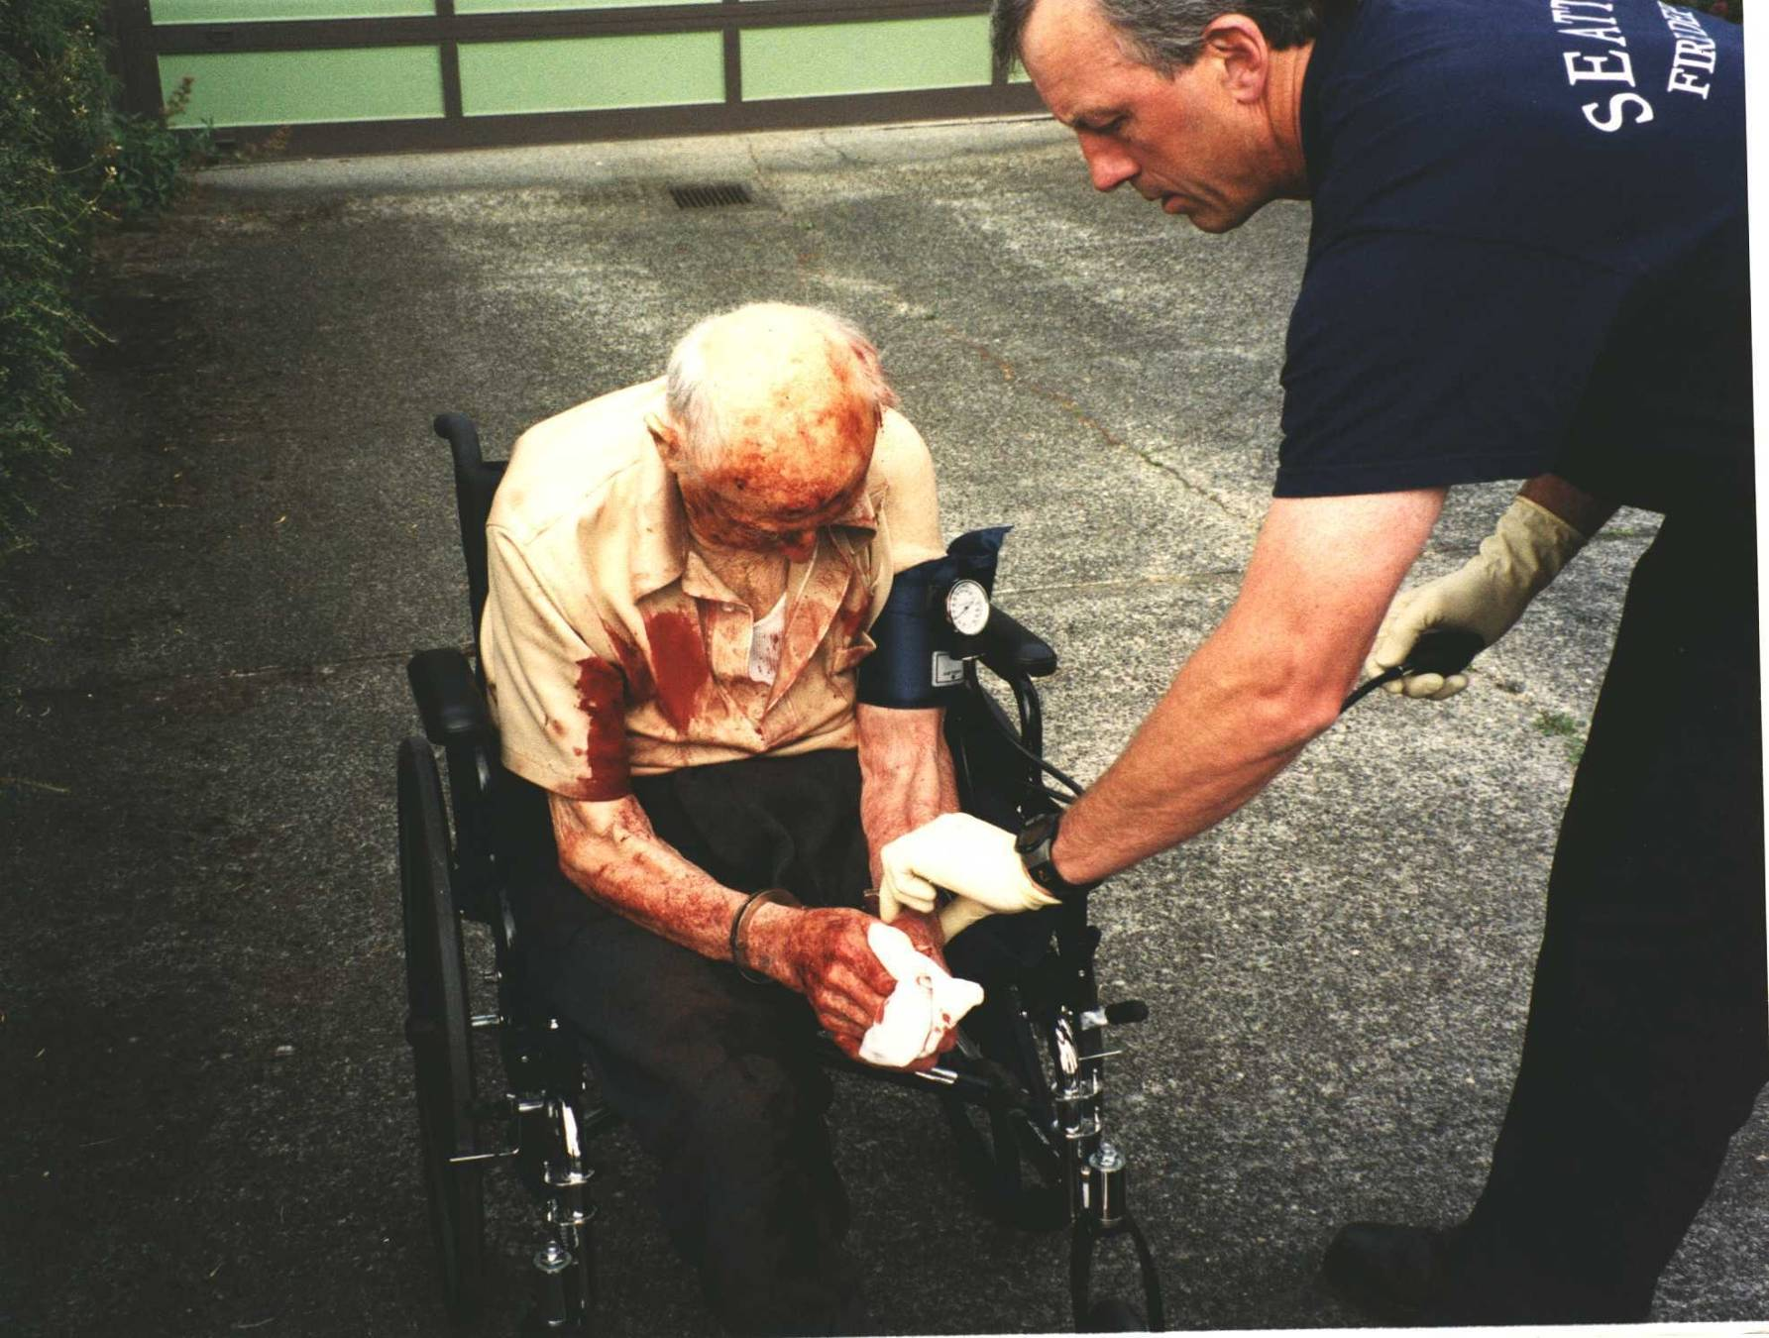
Photo
Notes:
Perpetrator

Slide 19
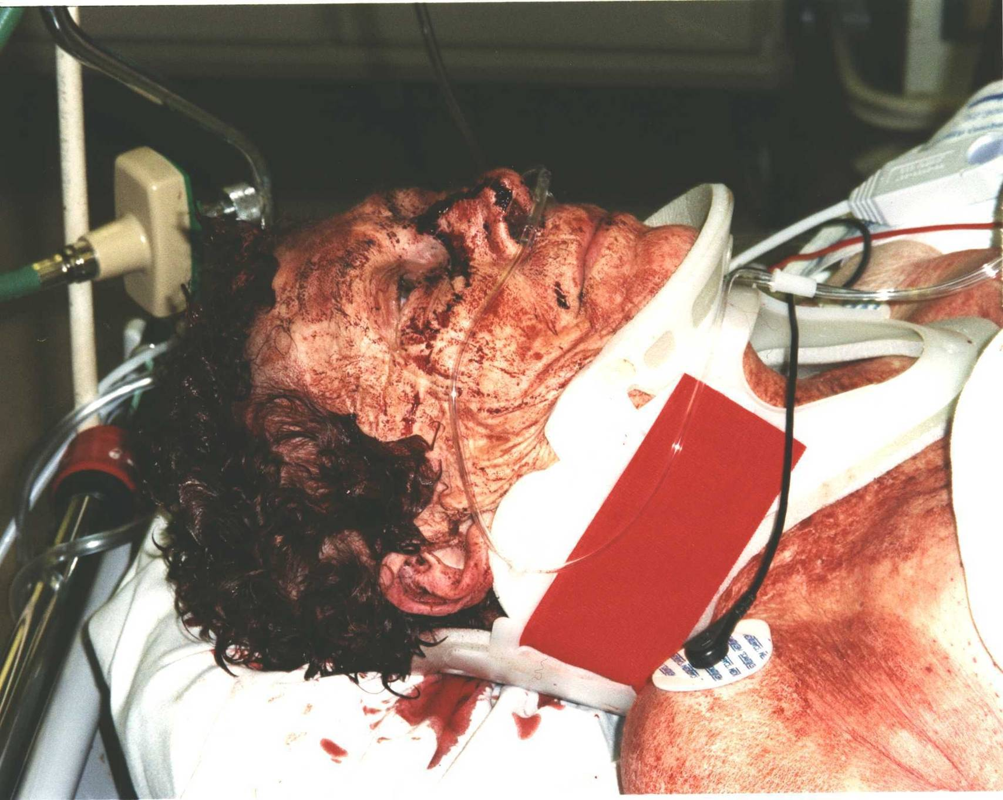
Notes:
Victim

Slide 20
Case Facts
Couple found lying on floor and covered in blood.
Husband had repeatedly hit wife with one-and-a-half inch lead pipe and cordless phone.
Offender claimed if he killed his wife he “would not have to worry about anything from her”.
She survived; he went to jail.
Notes:
The bullets below describe this King County, WA case in more detail.
Neighbors call 911 after finding a couple lying on the floor and covered with blood. This is the older man (photo). Given his appearance, the initial assumption was that he was the victim.
During the investigation officers learn that the husband is angry with his wife because he claims she did not sort his pills correctly.
The husband repeatedly hit his wife with a one and a half-inch lead pipe and a cordless phone.
This perpetrator claimed that if he killed his wife he would “not have to worry about anything from her.”
She survived; he went to jail.
Three photos accompany this case example: one of a man (perp in a wheelchair); one of the victim’s face; and one of the weapon (a lead pipe). The mace in the photo was not used in the attack.
***Instructor’s Note: Additional information is available in Appendix A.

Slide 21
Unique Types of Physical Abuse
In addition to traditional types of physical abuse (hitting, slapping), elder abuse may also include:
Overmedicating
Force feeding
Restraining
Smothering
Notes:
UNIQUE ASPECTS OF ELDER PHYSICAL ABUSE, BRUISING & STRANGULATION
Trainers: law enforcement, prosecutor
Slides: 5.10 - 5.15
Method: lecture, photo
Time allowed: 10 minutes
Unique Types of Physical Abuse
In addition to traditional types of physical abuse (hitting, slapping), elder abuse may also include:
Overmedicating
Force feeding
Restraining
Smothering
See indicators in the Instructor’s Mnual.

Slide 22
Bruising and Elder Abuse
Causation – accidents, medications, practices such as cupping and coining, abuse
Location – on face, on trunk or inner thighs are likely caused by abuse.
Explanation - Does the explanation seem plausible for the injury?
Notes:
Physical Abuse
Bruising - When investigating, consider the following:
Causation: There are a number of possible causes for bruises on older individuals including accidents, medications, blood draws, practices such as cupping and coining and, of course, abuse. Therefore, an investigation is needed to find out what happened.
Location: Bruises caused by accidents tend to be on the extremities of the body such as the arms and legs. Bruises by the eyes, in the mouth, on the trunk and inner thighs are more likely to be caused by abuse.
Ask the older adult how the injury occurred and for how long the older adult has had the injury. Does the explanation seem plausible for the injury?

Slide 23
Bruising and Elder Abuse
Bruises may be affected by:
  Medication
  Circulation and skin changes
  Pigmentation
Notes:
Bruises can be effected by medications, such as blood thinners, or as the result of circulation and skin changes. Bruises can be affected by skin pigmentation and may be more difficult to see on darker skin. Practices, such as cupping or coining, can result in markings that look like bruises but are not caused by abuse.

Slide 24
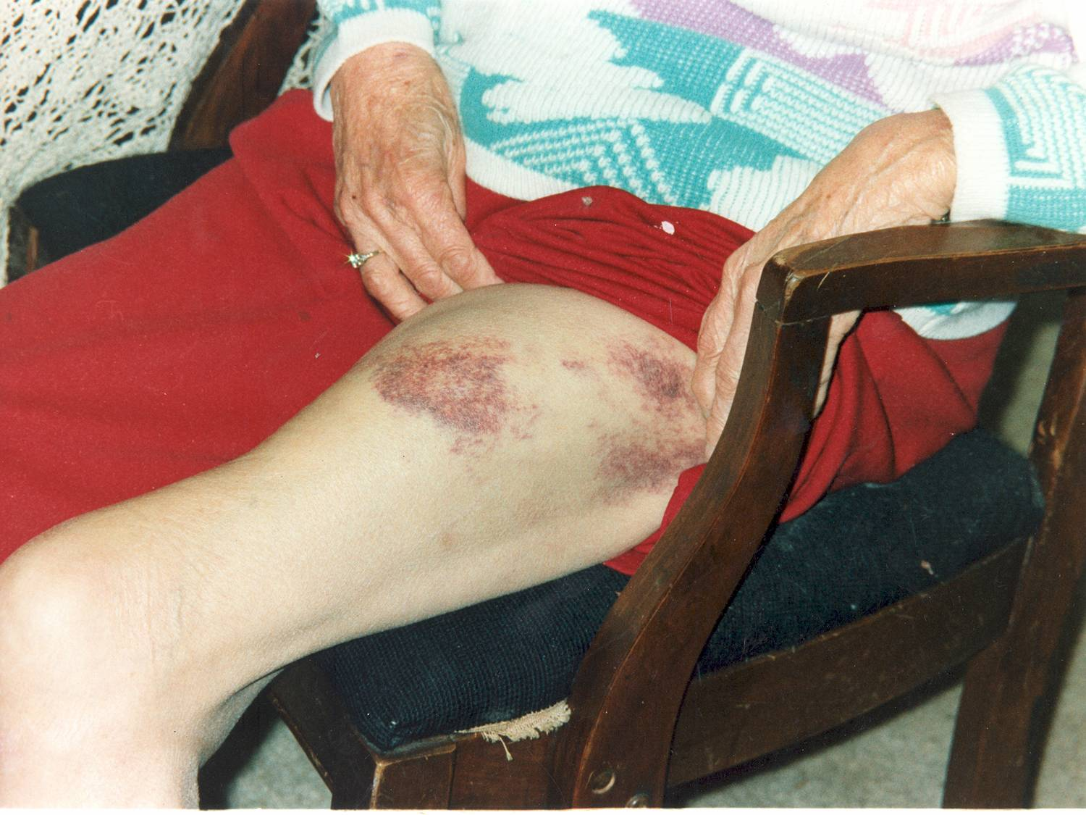
Hidden Bruises
Notes:
Physical Abuse
Show photo of hidden bruises. Most abusers will deliberately harm the victim on areas of the body that are normally covered by clothing.
***Instructor’s Note: Refer to the bruising handout in the Participant Materials, page 47.
***Instructors’ Note: The following information briefly describes cupping and coining practices, which are sometimes used as health remedies by some cultures. These practices can leave marks and bruises that look like elder abuse but may be part of an individual's health care practices.
Cupping
Cupping refers to an ancient Chinese practice in which a heated cup is applied to the skin so that the skin and superficial muscle layer is drawn into and held in the cup.
Coining
Coining is an alternative form of medicine most commonly practiced in Southeast Asia to reduce stress related symptoms in adults such as headaches, muscle aches and pain or low energy. The practice produces marks on the chest and back which can look like bruises and resolve over several days.
Summary
As in all cases, document physical injuries.
Not all bruising may be from criminal actions.

Slide 25
Elder Abuse Training for
Law Enforcement
Neglect
Notes:
Synopsis
This module will focus on defining and identifying key elements of a neglect investigation. The major segments include defining neglect and related statutes, interviewing, collecting evidence, documentation and determining if a case is neglect or self-neglect.
Performance Objectives
Given an incident involving possible neglect of an elder, the participant will be able to:
Define neglect.
Identify specific neglect statutes.
Identify key investigative strategies unique to neglect.
Equipment
Microphones, a LCD projector, a computer with speakers, and a screen are required. A flip chart and markers should be at each table for small group. Some presenters may want a flip chart at the front of the room. Paper and pens should be on the tables for each participant.
Power Point Slides: 6.1 – 6.37
Videos
20/20: Trixie and Daniel Gross produced by ABC (3:28 minutes)
Small Group Exercise
Neglect interviewing questions

Slide 26
What is Neglect?
Refusal/Failure to Provide
Food
Water
Clothing
Shelter
Personal hygiene
Medication
Medical care
Comfort
Personal safety
Other essentials
Notes:
DEFINING NEGLECT, INDICATORS, PRESSURE ULCERS AND STATUTES
Trainers: law enforcement, APS, prosecutor
Slides: 6.3 – 6.13
Method: lecture
Time allowed: 20 minutes
What is Neglect?
Neglect is defined as the refusal or failure of a caregiver to fulfill any part of that person's obligations or duties to care for an older adult. Neglect may also include the failure of a person who has fiduciary responsibilities to provide care for an older adult (e.g., to pay for necessary home care services), or the failure of a nursing home, adult family home, or in-home service provider to provide necessary care. Definitions are state specific.
Refusal or failure to provide an older adult with necessities such as:
Food
Water
Clothing
Shelter
Personal hygiene
Medication
Medical care
Comfort
Personal safety
Other essentials included in an implied or agreed-upon responsibility (contract to care for) to an older adult.
Some of these sound benign but cause severe suffering. These acts can be either overt acts or omissions.

Slide 27
Victim Indicators
Malnutrition
Poor hygiene
Unexplained changes in weight or cognition
Inappropriate clothing for weather or situation
Untreated pressure ulcers
Notes:
Neglect
Neglect Indicators Refresher
***Instructors’ Note: Present a short mini lecture on indicators. Refer participants to the handout on indicators in the Participant Materials for a more comprehensive list, page 51.
Victim Indicators
Suspect Indicators
Environmental Indicators
Victim Indicators (may include but are not limited to)
Dehydrated or malnourished
Poor hygiene
Unexplained changes in elder’s weight or cognition
Inappropriate clothing for weather or situation
Presence of untreated bedsores (pressure ulcers)

Slide 28
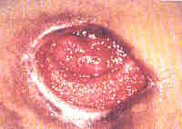
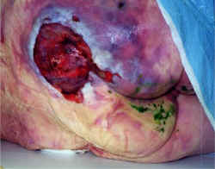
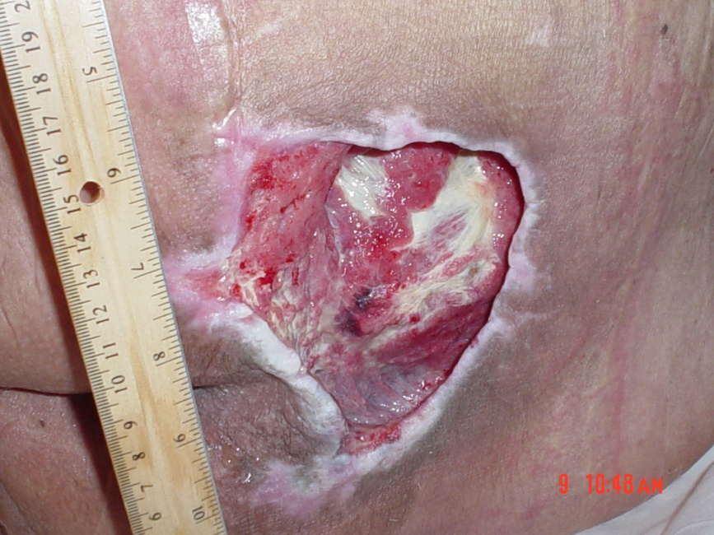
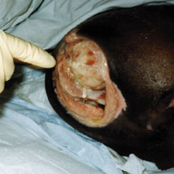
Pressure Ulcers
Notes:
28
28
SHOW “PRESSURE ULCER” PHOTOS
A pressure ulcer (sometimes called a bedsore by the general public) is a injury to the skin or tissues, usually over a bony area, that is the result of friction or weight on the area. For example, they can often be found on persons who are unable to leave their beds or wheelchairs if they have been left in one position for periods of time.
Pressure ulcers may be the result of neglect by the caregiver but can also occur even if good care is being given.
In health care records, pressure ulcers may be described from stage one (least severe) to stage four (most severe).

Slide 29
What to Look For
Other signs of neglect present
Pressure ulcers that are:
  Dirty or untreated
  Located on front of body
  On multiple parts of body
  Severe in size or depth
Notes:
What to Look For
Other signs of neglect present
Pressure ulcers that are:
dirty or untreated
located on front of body
on multiple parts of body
severe in size or depth

Slide 30
Some pressure ulcers are the effect of neglect, although they can occur, even with proper care
It is not the presence of the pressure ulcer that indicates neglect, but the absence of attempted medical care
Notes:
Some pressure ulcers are the result of neglect, although they can occur, even with proper care. It is not the presence of the pressure ulcer that indicates neglect, but the absence of attempted medical care.

Slide 31
Environmental Indicators
Strong odors of urine and/or feces
Lack of medication or assistive devices
Underfed or not properly cared for pets
Lack of utilities
Spoiled food
Infestation of insects or rodents
Notes:
Environmental Indicators
Environmental dangers resulting from basic safety and health standards not being met
Underfed or not properly cared for pets
Infestation of insects or rodents
House, roof, and/or yard in disrepair
Strong odors of feces and/or urine
Lack of utilities
Filthy bedding and/or clothing
Dirty or unused bathroom and/or kitchen
Broken, or absence of, needed medical equipment or aids such as eyeglasses, hearing aids, walkers and wheelchairs.
Spoiled food

Slide 32
Why Does Neglect Occur & Persist?
Well-intended caregivers
Physical or mental health conditions
Greed
Power and control
Notes:
Why Does Harm and/or Neglect Occur and Persist?
Well-intended caregivers
Physical or mental health conditions
Greed
Power and control

Slide 33
What is Self-Neglect?
The same as neglect, indicators often look similar, except no caregiver is involved.
Notes:
INITIAL RESPONSE: NEGLECT OR SELF-NEGLECT AND SUMMARY
Trainers: APS, law enforcement
Slides: 6.31 – 6.37
Method: lecture, photos, group discussion
Time allowed: 10 minutes
What is Self-Neglect?
The indicators of self-neglect often look the same as neglect, except that no caregiver is involved.
Self-neglect generally manifests itself as a refusal or failure to provide himself/herself with adequate:
Food
Water
Clothing
Shelter
Personal hygiene
Medication (when indicated)
Safety precautions.

Slide 34
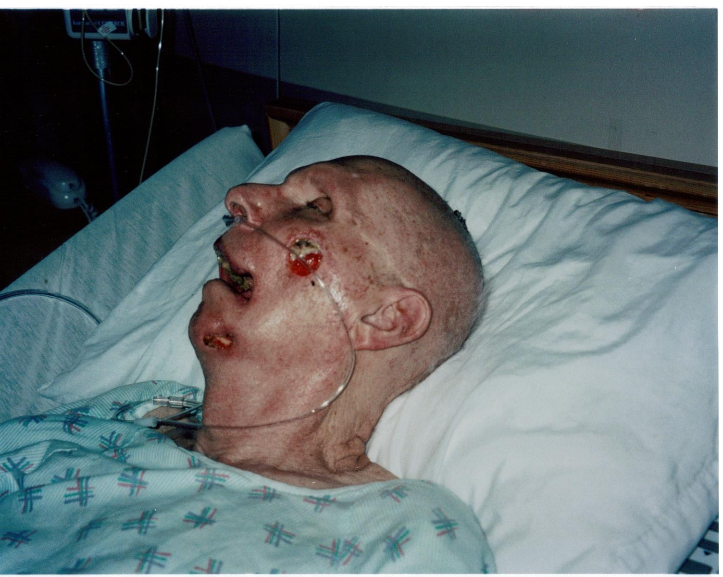

Slide 35
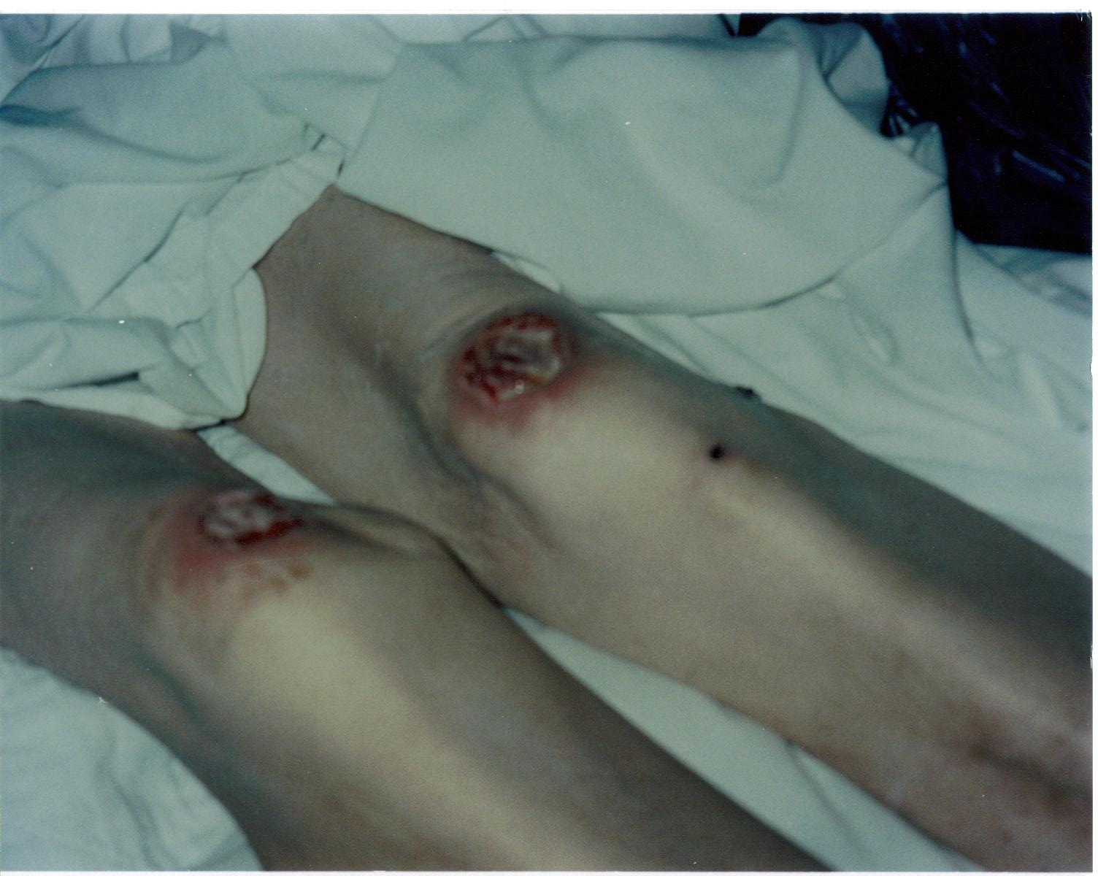
Photo
Case example 1 – older adult male victim
Notes:
GROUP DISCUSSION
Is this self-neglect or neglect?
Do we have enough information at this time to make a determination?
(The answer is no.)
***Instructor’s Note: This was a case of neglect. There is additional information in Appendix A.

Slide 36
Neglect or Self-Neglect?
Case Example
Older male, living alone
Found after several days of lying face down on bathroom floor
Pressure sores on face, chest, knees, groin
Appeared to have dementia
Notes:
Case Example: Self Neglect or Neglect
Describe the following scenario for participants.
An older male, who lives alone, was found unclean and incapacitated, lying face-down on his bathroom floor, where he had been lying for days before he was discovered. He had bed sores (pressure sores or decubitis ulcers) on his face, chest, knees, and groin. He appeared to have dementia.
SHOW PHOTO OF OLDER MALE VICTIM IN BED
SHOW PHOTO OF HIS INJURIES

Slide 37
Elder Abuse Training for
Law Enforcement
Sexual Abuse
Notes:
7.37
Synopsis
This module will focus on key elements of investigating sexual abuse/assault and/or stalking of an older individual.
Performance Objectives
Given an incident involving possible sexual abuse or stalking of an elder, the participant will be able to:
Identify relevant state statutes.
Define elder sexual abuse and potential indicators.
Define stalking and its unique aspects in later life.
Equipment
Microphones, an LCD projector, a computer with speakers, and a screen are required. A flip chart and markers should be at each table for small group. Some presenters may want a flip chart at the front of the room. Paper and pens should be on the tables for each participant.
PowerPoint Slides: 7.1 – 7.27
Videos
Miss Mary (2:07 minutes) Women’s Center of Jacksonville
Velva ( 5:03 minutes) California POST
Small Group Exercises
None

Slide 38
What is Elder Sexual Abuse?
Any nonconsensual, unwanted sexual contact with an older adult
Notes:
What is Elder Sexual Abuse?
Elder Sexual Abuse is:
Any nonconsensual, unwanted sexual contact with an older adult.

Slide 39
Who Commits Elder Sexual Abuse?
Adult family members, such as adult sons or daughters, grandchildren, siblings
Spouses and intimate partners
Non-relative caregivers
Residents in facility settings
On-line predators
Stranger or acquaintance (least frequent)
Notes:
Who commits elder sexual abuse?
Like most other forms of elder abuse, in most cases, the victim knows or has an ongoing relationship with the perpetrator.
Offenders may be:
Adult family members, such as adult sons, including children, grandchildren, siblings
Spouses and intimate partners
Non-relative caregivers
Residents in facility settings
On-line predators
Stranger or acquaintance (least frequent)

Slide 40
Why Does Elder Sexual Abuse Occur?
Power and control
Mental health or dementia (inability to control behavior)
Notes:
Why Does Elder Sexual Abuse Occur and Persist?
Power and control
Mental health conditions or some stages of dementia result in persons not being able to control their behavior.
Generally sexual predators use sexual acts to dominate, punish, humiliate, and control a victim. Some sexual abusers target older women because they believe seniors are vulnerable or less likely to fight back, report the rape, or be believed.
In rarer situations, a person with certain types of dementia may display inappropriate sexual behavior as a symptom of the dementia progression. These behaviors are normally new and inconsistent with prior patterns of conduct. The person may engage in inappropriately fondling others or compulsive masturbation in public. This may appear to be a form of sexual aggression but, in these instances, is not typically the result of power and control issues. The person may not know what she/he is doing is wrong. Regardless of the intent, victims of these behaviors are impacted and steps should be taken to protect the victim from further attacks. It is also important to offer supportive services.
If an officer is told that a suspect has Alzheimer’s disease or another dementia, contacting your local APS, Crisis Response Team or a Dementia Diagnostic Center may be more appropriate than arrest. These agencies can help assess the situation and identify interventions.

Slide 41
Potential Physical Signs of Sexual Abuse
Infections, pain, or bleeding in genital areas or mouth
Difficulty walking or sitting
Torn, stained, and/or bloody clothing including underwear, bedding, or furnishings
Notes:
Potential Physical Signs of Sexual Abuse
Infections, pain, or bleeding in genital areas or mouth
Difficulty walking or sitting
Torn, stained, and/or bloody clothing including underwear, bedding, or furnishings

Slide 42
Potential Physical Signs of Sexual Abuse
Bruises to outer arms, chest, mouth, genitals, abdomen, pelvis, or inside thighs
Bite marks
Unexplained STDs or HIV
Notes:
Bruises to outer arms, chest, mouth, genitals, abdomen, pelvis, or inside thighs
Bite marks
Unexplained STDs or HIV

Slide 43
Potential Behavioral Cues
Unexplained or sudden changes such as:
  Mood or temperament
  Personal hygiene
  Substance use or abuse
  Sudden avoidance or fear of specific people
  Sleep disturbances
  Recent resistance to certain kinds of caregiving such as bathing
Notes:
Potential Behavioral Cues
The behavioral signs of elder sexual abuse include, but are not limited to,
unexplained or sudden changes such as:
Mood or temperament
Personal hygiene
Substance use or abuse
Sudden avoidance or fear of specific people
Sleep disturbances
Recent resistance to certain kinds of caregiving such as bathing

Slide 44
Behavioral Definition: Stalking
Pattern of repeated, unwanted attention, harassment, and contact directed at specific person that would cause a reasonable person to feel fear.
Notes:
What is Stalking?
Behavioral Definition
Stalking is a pattern of repeated, unwanted attention, harassment, and contact directed at a specific person that would cause a reasonable person to feel fear.

Slide 45
Stalking in Later Life
Older adults are almost as likely to be stalked as younger individuals.
Often, stalker is someone who the older adult victim knows.
Stalking in later life is often part of domestic violence.
Stalkers may use technology to stalk their victims.
Notes:
Transition: “As you can see on this slide, research indicates that older individuals are also victims of stalking.”
Stalking in Later Life
Older adults are almost as likely to be stalked as younger individuals
The stalker is often someone whom the older victim knows.
Stalking in later life is often part of domestic violence.
Stalkers may use technology to stalk their victims.
Many victims who are older or have a disability may not be believed if they report stalking, particularly if the victim has dementia. Others may not be believed because of the frailty or disability of the stalker.
Because caregivers are aware of their patients’ routines and habits, persons who require a caregiver are vulnerable to stalking and extremely easy to track.
Increasingly, stalkers are using technology stalk their victims. The availability of phone, computer and GPS technologies provide stalkers a variety of tools to use to locate and intimidate their victims. Global positioning systems can track a person’s location, caller ID can be used to monitor calls or to locate a victim after she/he has fled. Online databases, electronic record, and web search engines are use to locate, track and harass victims.

Slide 46
Elder Abuse Training for
Law Enforcement
Abuse in Facility Settings
Notes:
MODULE 8: Abuse in Facility Settings
Synopsis
This module will focus on key elements of investigating abuse and neglect in facility settings.
Performance Objectives
Given a possible incident of elder abuse or neglect in a facility setting, the participant will be able to:
Identify relevant statutes.
Describe challenges and strategies to overcome barriers in facility investigations.
List organizations/agencies involved in abuse in facility investigations.
Equipment
Microphones, an LCD projector, a computer with speakers, and a screen are required. A flip chart and markers should be at each table for small group. Some presenters may want a flip chart at the front of the room. Paper and pens should be on the tables for each participant.
PowerPoint Slides: 8.1 – 8.18
Videos
None
Small Group Exercises
Challenges of facility investigations

Slide 47
Types of Facility Settings
Skilled nursing facilities
Residential care facilities
Assisted Living Facilities
Adult family (group) homes
Notes:
Facilities
WHAT IS ABUSE IN FACILITIES?
Trainers: APS/law enforcement
Slides: 8.3 – 8.4
Method: lecture
Time allowed: 5 minutes
Types of Facility Settings
Facility settings that provide temporary or permanent care to seniors include:
Skilled nursing facilities (SNFs or nursing homes) provide skilled care under the supervision of medical professionals.
Residential care facilities (RCFs) are community-based residential facility settings that provide housing, meals, limited nursing care, and personal services (e.g., assistance with bathing, dressing, etc.) to people who are unable to perform all of their daily activities but who do not require extensive medical care. Each state will have its own definition and licensing requirements. Some facilities are referred to as “assisted living,” and can range from independent senior apartments to specialized care assisted living.
Adult family (group) homes provide a residence for multiple adults residing in one residence with an individual who provides care and operates the home.
Graduated housing provides additional services and care as residents’ health care needs increase.
Hospice (when using a fixed facility setting rather than only services available to patients) is a facility setting providing end of life care to terminally ill persons and licensed according to each state’s requirements.
In all cases your state’s regulatory agency will determine the type of facility setting when they issue the license.
*There are subsection of some of the facilities listed. Note some of the subsections…

Slide 48
1. Victim Issues
One individual harmed by one suspect
Multiple individuals harmed by one suspect
Multiple individuals harmed by the facility practices administered by multiple staff (facility-wide abuse)
Notes:
1. Victims in Facilities
One individual harmed by one suspect
Multiple individuals harmed by one suspect
Multiple individuals harmed by the facility practices administered by multiple staff (facility wide abuse)

Slide 49
1. Victim Issues
Potential significant physical and cognitive limitations – may not be able to report crime or be seen as credible
May be afraid to report due to repercussions
Notes:
Victim Issues
Victims may have significant physical and diminished cognitive function that make it difficult to recognize they have been victimized, make it difficult to report, and they may not be believed.
Victim is afraid to report due to repercussions.

Slide 50
3. Staff and Environmental Issues
Delays in reporting
Facility or staff fail to report or attempt to cover up abuse
Evidence may be contaminated or destroyed
Notes:
3. Staff and Environmental Issues
Delays in reporting
Facility staff fails to report or attempt to cover up abuse, try to deny law enforcement access.
Evidence may be contaminated or destroyed

Slide 51
2. Number of Potential Suspects
Staff or administrators
Other residents
Family members
Volunteers
Guests of other residents
Faith leaders or representatives
Notes:
2. Increased Number of Potential Suspects
Staff or administrators
Other residents
Family members
Volunteers
Guests of other residents
Faith leaders/members
Consider Predators
Some staff members choose to work in facility settings to have easy access to victims who may be unlikely to report or to be believed.
Sexual predators who lived in the community or were released from prison/jail and are now themselves residents may continue to sexually assault victims. In some states, the facility setting may not be authorized to alert residents or their families that a sexual predator lives at the facility. In some cases, convicted pedophiles (including residents) have targeted and sexually assaulted older adults who appear to be easy prey.
Batterers or abusive family members may continue to harm an older adult living in a facility setting during visits or on field trips.
Delivery staff, volunteers, or family members of other residents may take advantage of residents.
A physical disability does not exclude an individual from being a sexual predator.

Slide 52
4. Facility-wide abuse
Frequent errors in the administration of medication
Excessive rates of preventable injuries, health problems, falls, malnourishment, and pressure ulcers or sores
Insufficient resources and staff or deliberate understaffing and lack of resources
Notes:
Facilities
Frequent errors in the administration of medication.
Excessive rates of preventable injuries, health problems, falls, malnourishment, and pressure ulcers or sores.
Insufficient resources and staff or deliberate understaffing and lack of resources to provide residents with food, care, or medication leading to malnutrition, dehydration, pressure ulcers or sores, sepsis, amputations, or death.
***Instructor’s Note: The Participant Materials include information on interviewing and evidence collection in facility settings, pages 73 & 77.
Transition: “Next, we will talk about agencies that may investigate abuse in facilities.”

Slide 53
Elder Abuse Training for
Law Enforcement
Financial Exploitation
Notes:
Synopsis
This module will focus on the dynamics of financial exploitation.
Performance Objectives
Given a possible incident of financial exploitation, the participant will be able to:
Define financial exploitation.
Identify statutes related to financial exploitation.
Identify investigative strategies unique to financial exploitation.
Equipment
Microphones, a LCD projector, a computer with speakers, and a screen are required. A flip chart and markers should be at each table for small group. Some presenters may want a flip chart at the front of the room. Paper and pens should be on the tables for each participant.
PowerPoint Slides: 9.1 – 9.22
Videos
None
Small Group Exercises
Working the Case - Johnson

Slide 54
What is Financial Exploitation?
Illegal or improper use of an older adult's funds, property or assets.
Since not all older adults use the banking system, consider cash, gold, jewelry, antiques, regalia/native artifacts and homes as assets.
Notes:
Financial Exploitation
WHAT IS FINANCIAL EXPLOITATION?
Trainers: prosecutor, law enforcement
Slides: 9.3 – 9.12
Method: lecture,
Time allowed: 20 minutes
What is Financial Exploitation?
Financial or material exploitation is defined as the illegal or improper use of an older adult's funds, property, or assets.
Keep in mind that not all older individuals use the banking system. Assets and resources may be cash at home, gold, jewelry, antiques, or the value of the home itself. This may be especially true for immigrants and persons who lived through the Depression.

Slide 55
Who Commits Financial Exploitation?
Family members, partners, and trusted individuals
Caregivers
Faith leaders and representatives
Interpreters/translators who have a unique trust relationship
Strangers may become “friends” (Sweetheart scams)
Notes:
Who Commits Financial Exploitation?
Family members, partners, and trusted individuals commit most of the financial exploitation of older persons. Family members may feel entitlement and greed. They may justify the exploitation claiming that an aging parent treated them badly in their youth, was demanding in later life, or that the family member needed the money or other asset and were to inherit it anyway. The suspect may be an older adult who is eligible for aging services.
Caregivers may steal or convince an older person to give them gifts.
Faith leaders or members of a faith community may also financially exploit an older adult.
Translators and interpreters are in a unique position to isolate and financially exploit an older adult who speaks no or limited English.
Strangers may become “friends” and financially exploit an older person. Sweetheart scams occur when a suspect targets a lonely older person, provides false information to elicit sympathy and develop a relationship, and then quickly marries the older person. In the process, the suspect gains legal authority or control over the older person’s estate and then depletes it. Such cases may also end in abandonment or homicide.
Court appointed guardians or persons with powers of attorney.

Slide 56
Methods of Financial Exploitation
Scams and identity theft (stranger)
Theft, coercion, and fraud
Undue influence
Abuse of legal authority (i.e., Power of Attorney)
Notes:
Financial Exploitation
How does financial exploitation occur?
Scams and identity theft
Theft, fraud, coercion
Undue influence
Abuse of legal authority
Transition: “The list on the slide describes methods that may be used to commit financial exploitation. This training does not focus on scams, identify theft, theft, fraud or coercion, because other trainings and materials are available on these topics. Next, we will briefly define undue influence and discuss powers of attorney and guardianships.”
***Instructor’s Note: Refer to Resources on Scams handout in Participant Materials, page 81.

Slide 57
Powers of Attorney and Guardianships
Power of Attorney
  An instrument which delegates authority to make decisions or financial management to another
Guardianships
  A court order granting certain powers to a family member, other individual, governmental agency, or institution to control the affairs of another person
Notes:
Abuse of Legal Authority
Powers of Attorney and Guardianships
Power of Attorney (POA): An instrument by which one person delegates authority to make decisions such as medical care, end of life decisions, or financial management to another.
POA forms can be downloaded over the internet or purchased at office supply stores. They can be completed and signed by anyone. Victims are often coerced or tricked into signing the POA. There is no court or other oversight of POAs.
***Instructors’ Note: Pass a copy of a POA around the room.
Guardianship/Conservatorship: A mechanism by which a court grants certain powers to a family member, other individual, governmental agency, or institution to control the affairs of a person who is incapable of managing for him or herself. Courts generally require medical reports about the mental capacity of the individual before appointing a guardian.
***Instructors’ Note: The same term may mean something different from one jurisdiction to another. Therefore, it is critical that local definitions and requirements be reviewed before teaching this section and state-specific information is substituted for the generic descriptions provided here.

Slide 58
Local Agencies
APS/DHS
Long-Term Care Ombudsman programs (LTCOPs)
Coroners and medical examiners
CTUIR Family Violence Services Program
8.58
Notes:
People that can help with elder abuse cases….etc.

